Slide 1
جلسه اول- فهرست مطالب، ارزیابی، منابع، معرفی مدارک سیسکو (p4)، عنوان پروژه ها
جلسه دوم- توپولوژی فیزیکی و منطقی (p9)، کابل straight,cross,rollover(p12-21)، معرفی تجهیزات (hub, switch, router)، collision domain, broacast domain
جلسه سوم- معرفی محیط Packet Tracer، مدهای IOS و دستورات اولیه (p28-32)، startup-config, running-config (p33-35)
جلسه چهارم- انواع حافظه (p23,24)، دستور ping، دستور arp –a و show mac-address-table، استفاده از capture/forward برای ping و arp
جلسه پنجم- روشهای دسترسی به روتر (p25-27)، telnet و ssh (p36-39)
جلسه ششم-

Slide 2
CCNA 1
Chapter 0 - Introduction

Slide 3
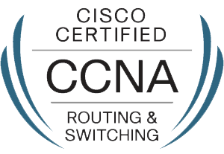
CCNA R&S
200-125

Slide 4
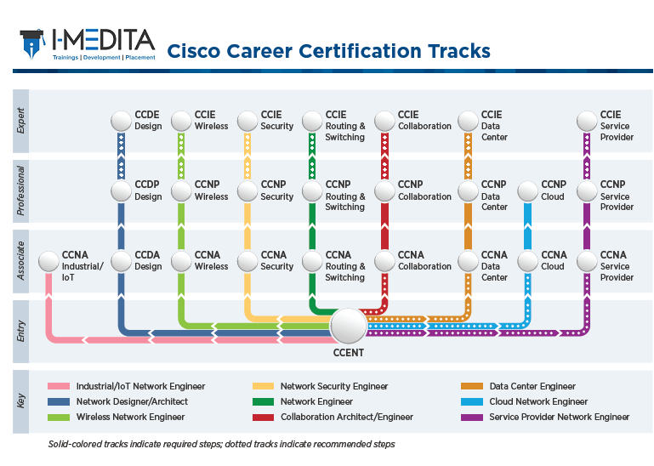
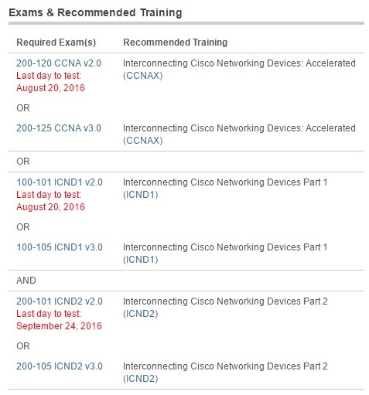

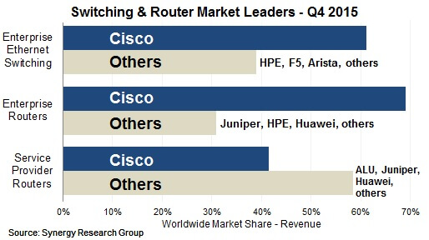
معرفی دوره
Cisco Certified Network Associate (CCNA)
Cisco Certified Network Professional (CCNP)
Cisco Certified Internetwork Expert (CCIE)
معرفی شرکت سیسکو
دوره ها و گواهی نامه های سیسکو
CCNA R&S چیست؟
اعتبار مدرک و انقضای مدرک
Tomorrow Start Here

Slide 5
CCNA 1
Chapter 1 - Exploring the Network

Slide 6
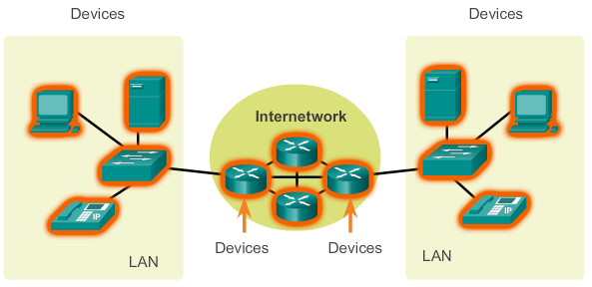
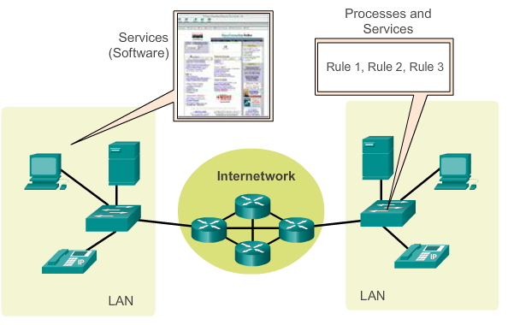
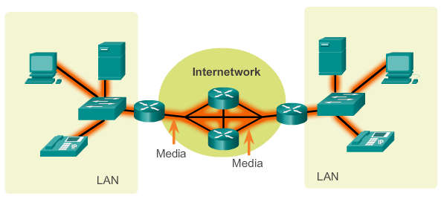
LANs, WANs, and Internets
Components of a Network
There are three categories of network components:
Devices
Media
Services
Notes:
1.2.1.1 Components of the Network

Slide 7
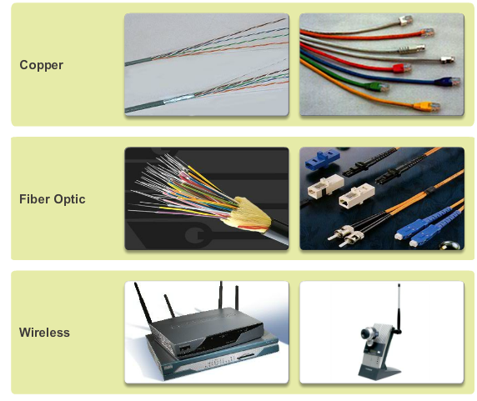
Components of a Network
Network Media
Notes:
1.2.1.4 Network Media

Slide 8
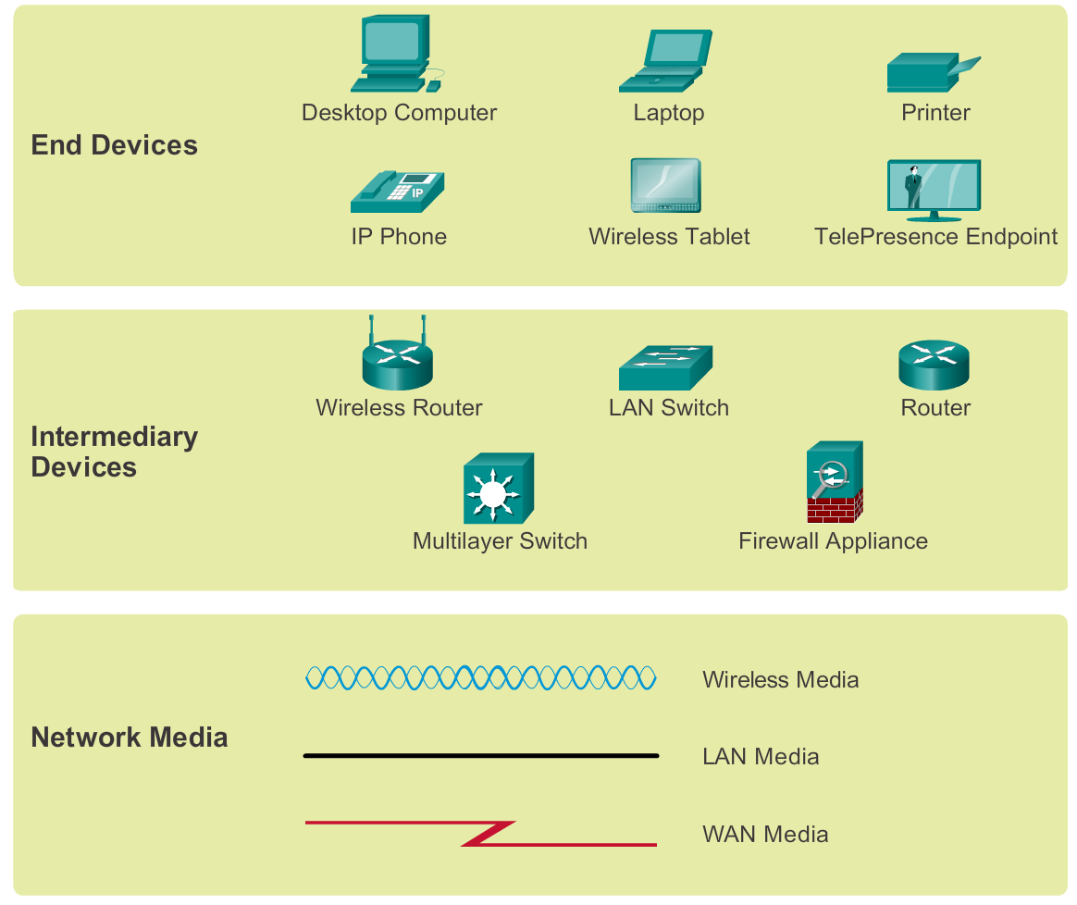
Components of a Network
Network Representations
Notes:
1.2.1.5 Network Representations

Slide 9
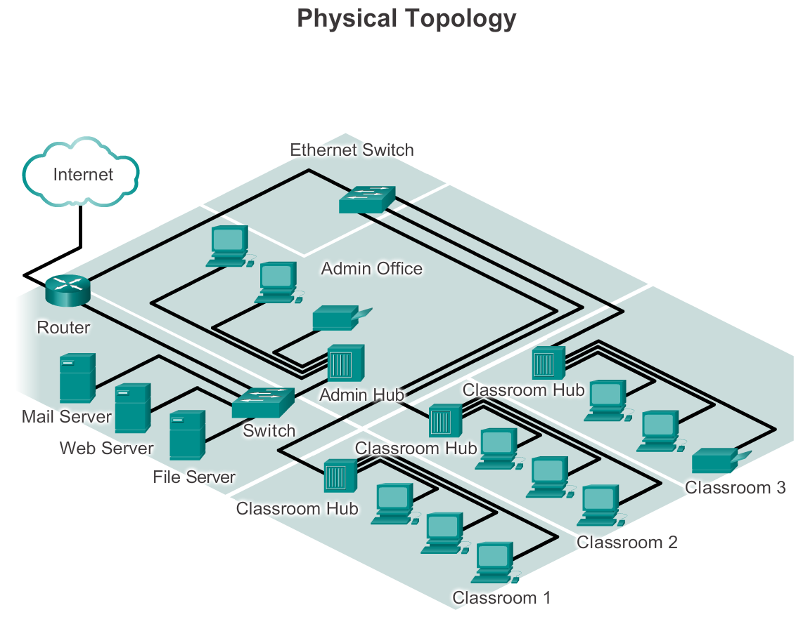
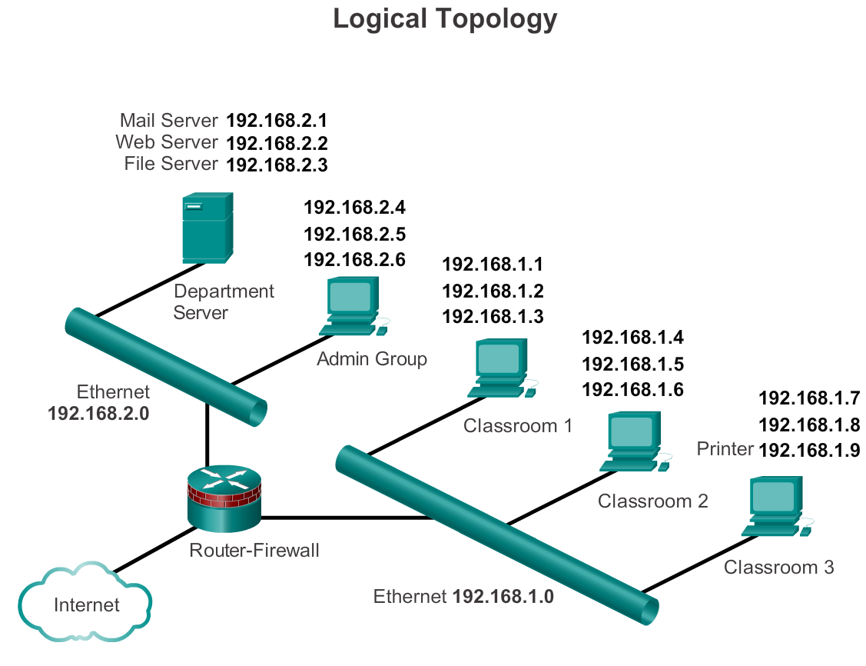
Components of a Network
Topology Diagrams
Notes:
1.2.1.6 Topology Diagrams

Slide 10
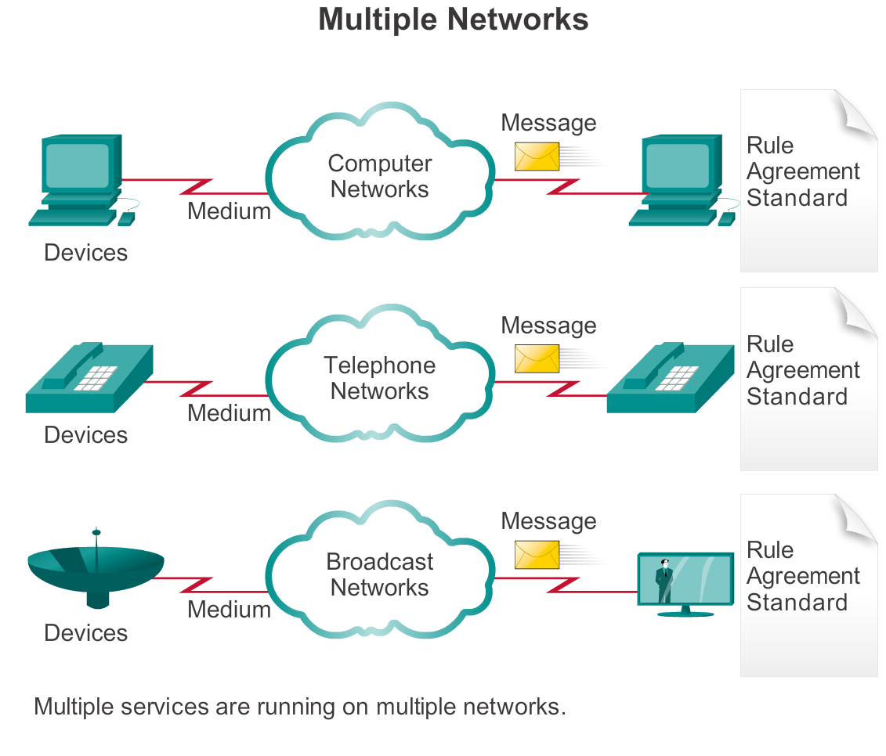
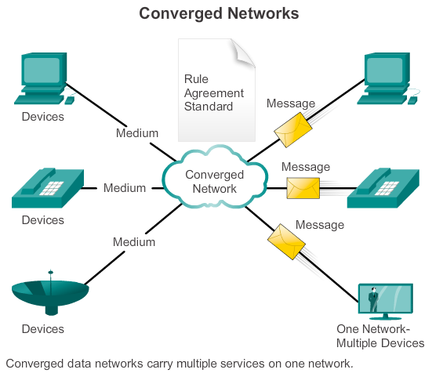
Converged Networks
The Converging Network
Notes:
1.3.1.1 The Converging Network

Slide 11


Network Architectures
Cisco Certified Network Associate (CCNA)
Notes:
1.4.4.2 CCNA

Slide 13
Up to slide 30

Slide 15
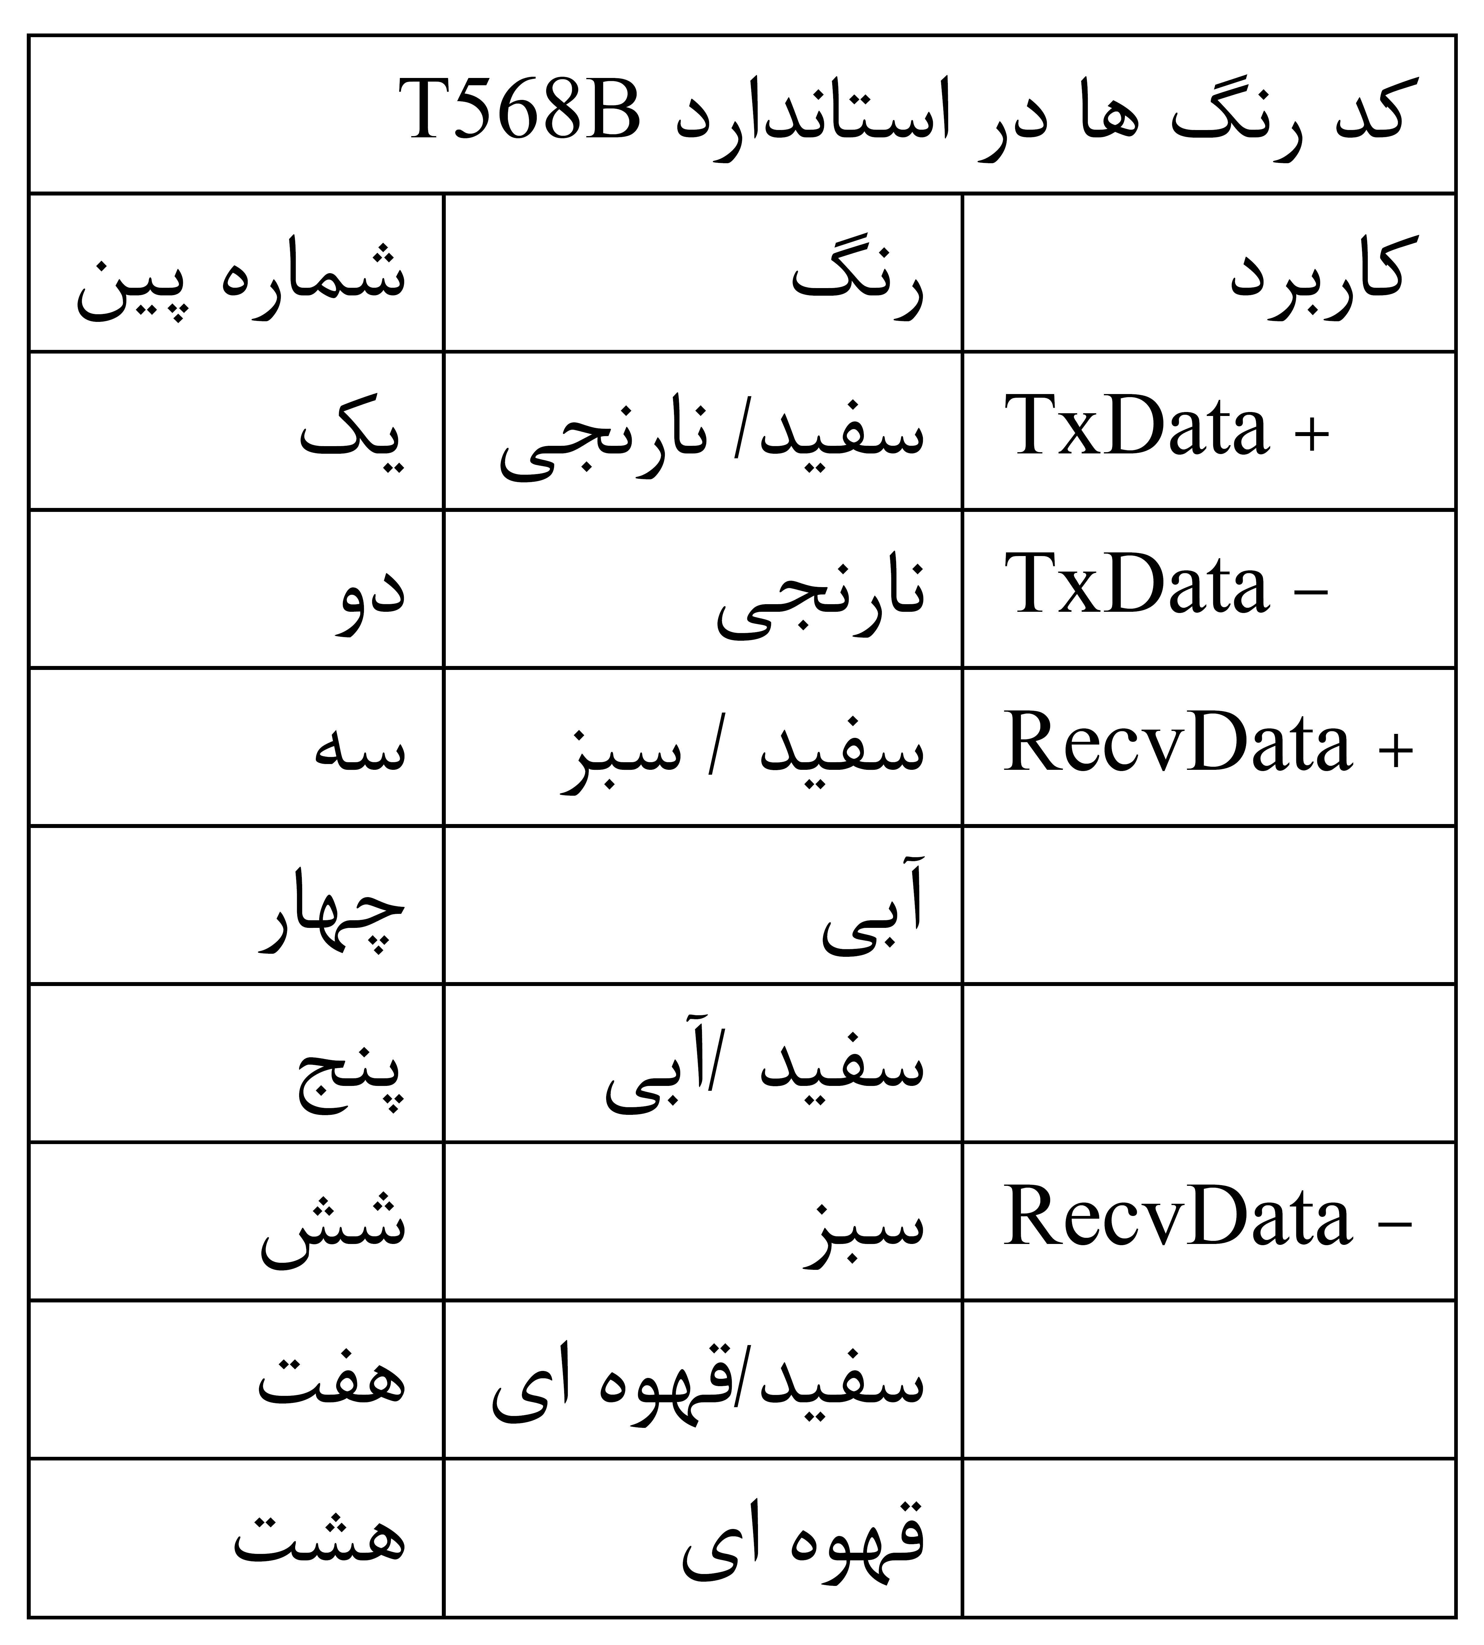

Slide 16
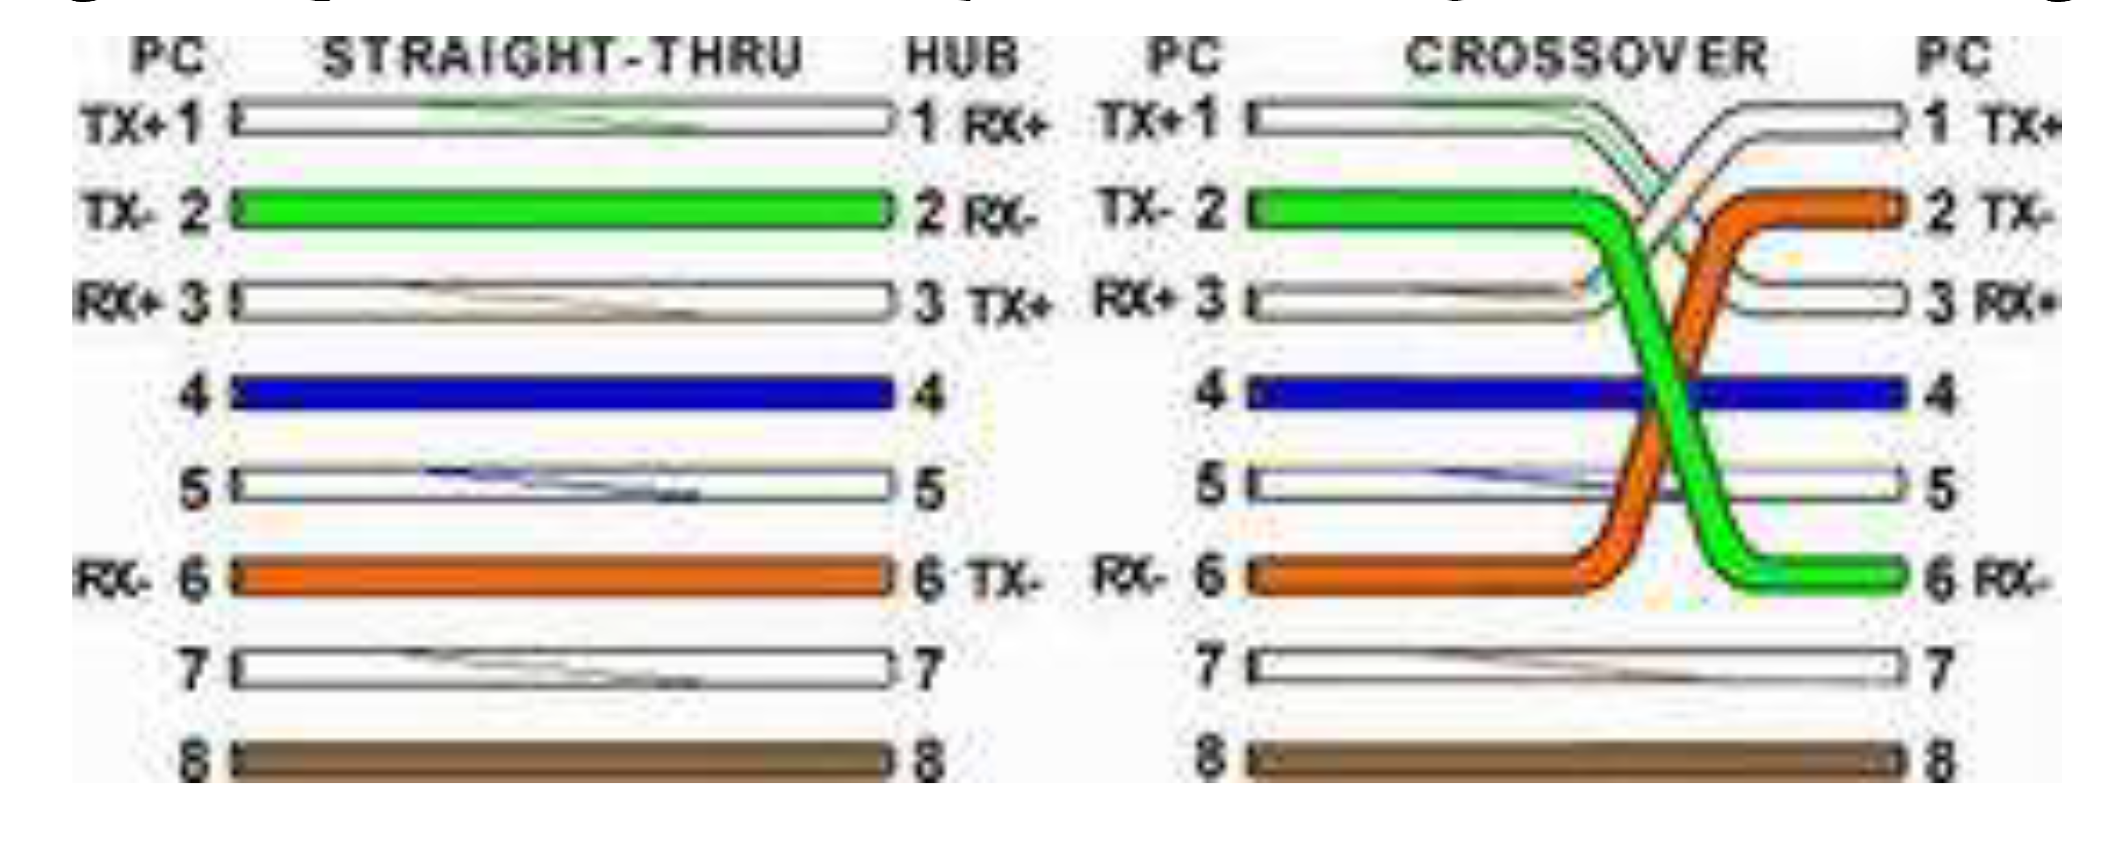

Slide 18
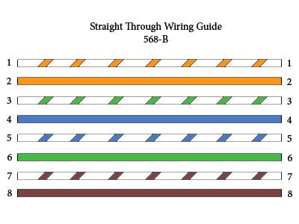

Slide 19
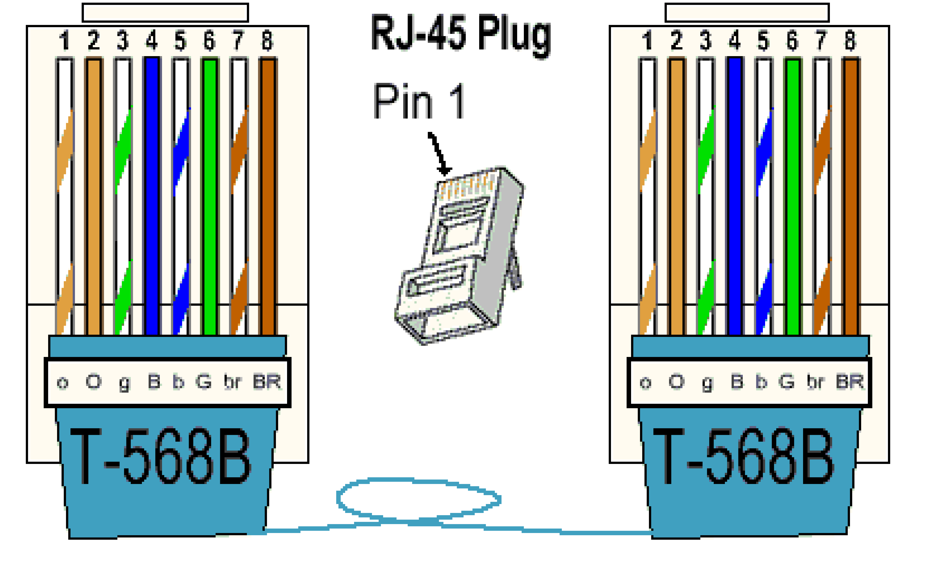

Slide 20
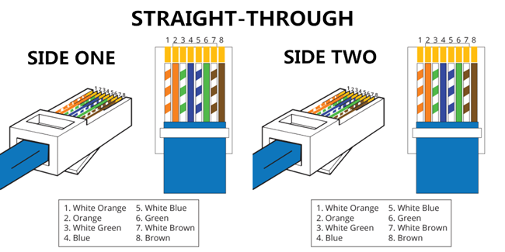

Slide 22
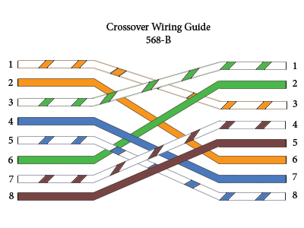

Slide 23
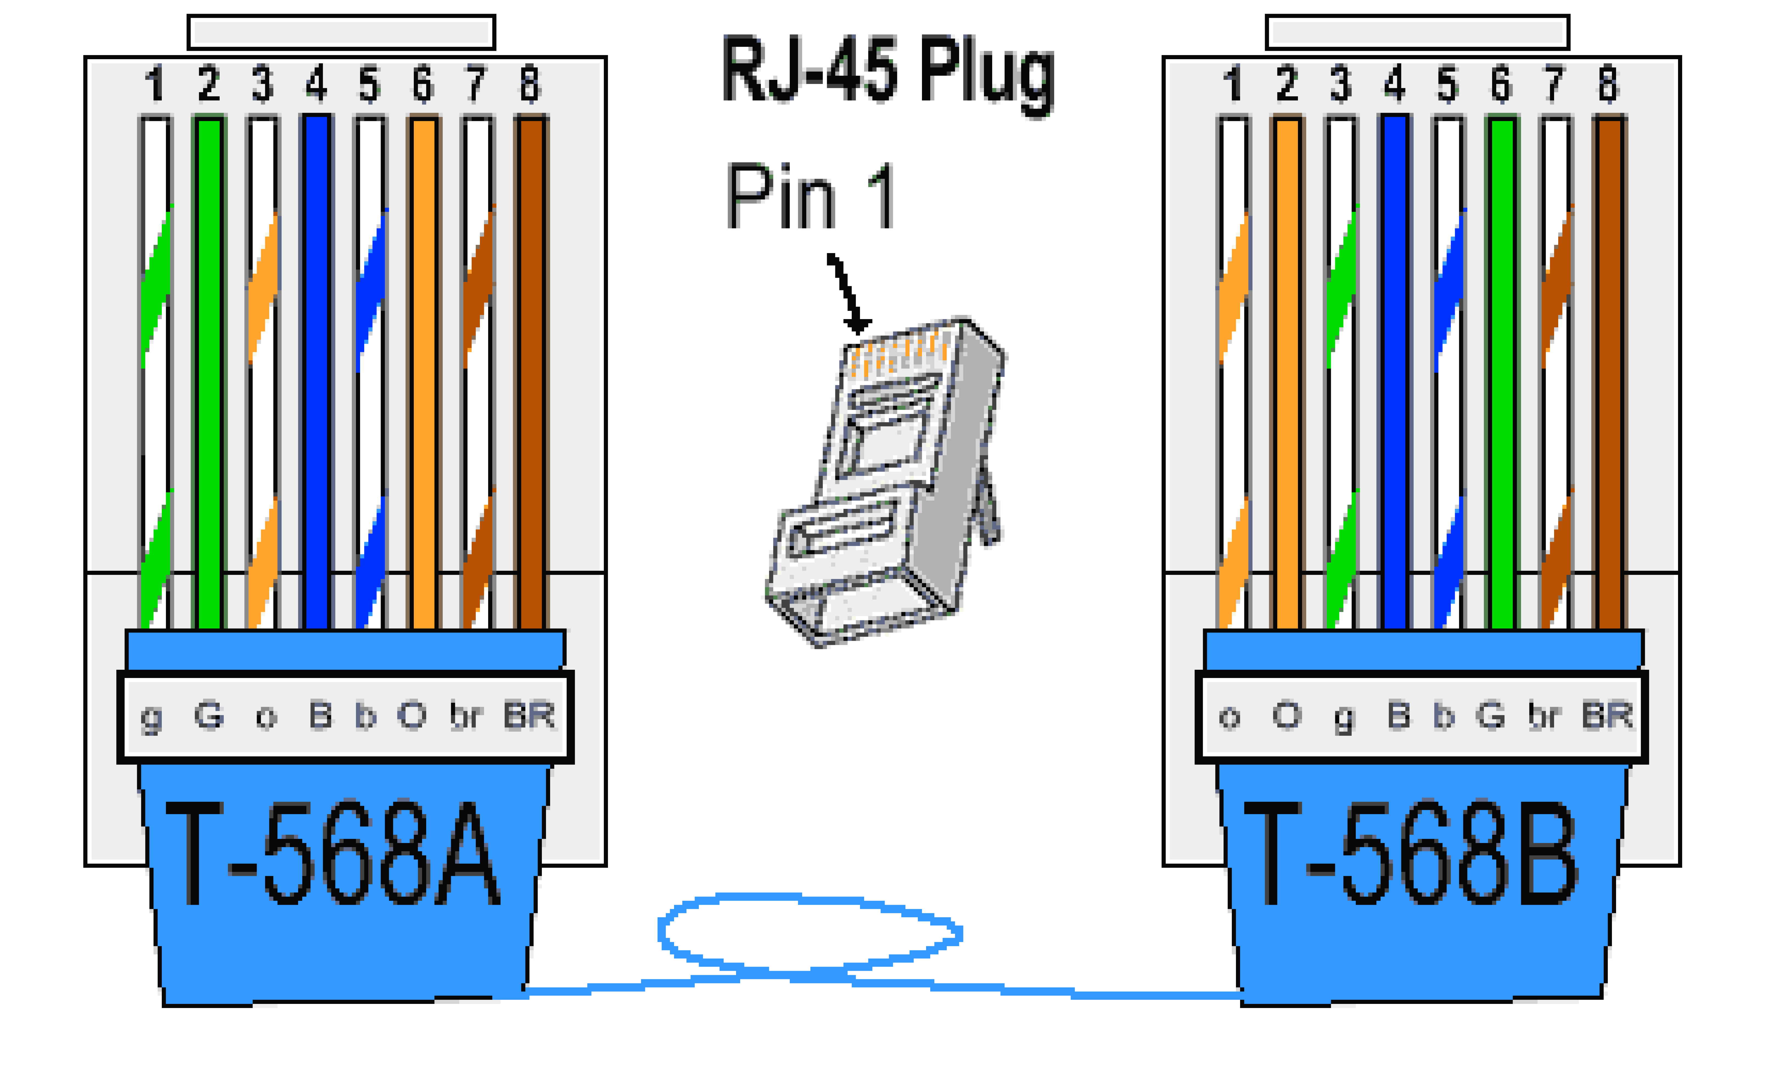

Slide 24
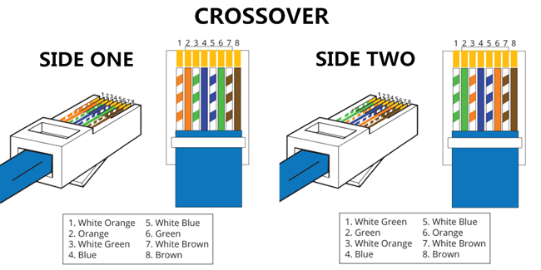

Slide 25
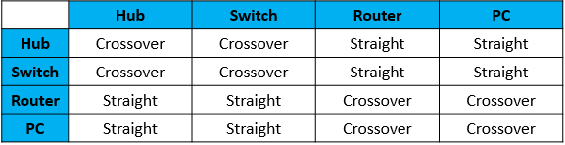

Slide 26
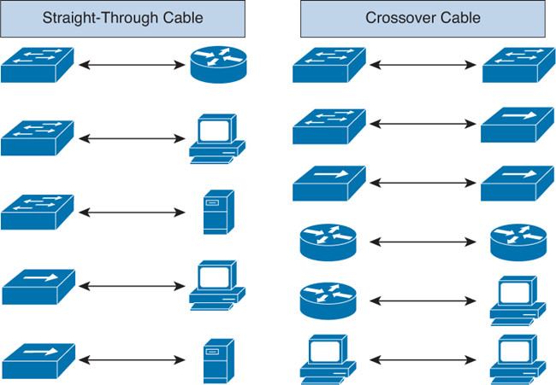

Slide 27
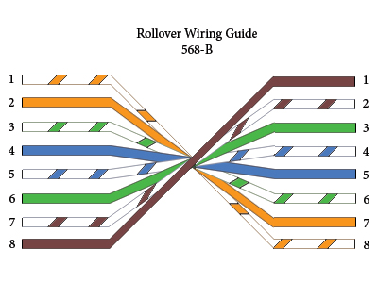

Slide 29
CCNA 1
Chapter 2 - Configuring a Network Operating System

Slide 30
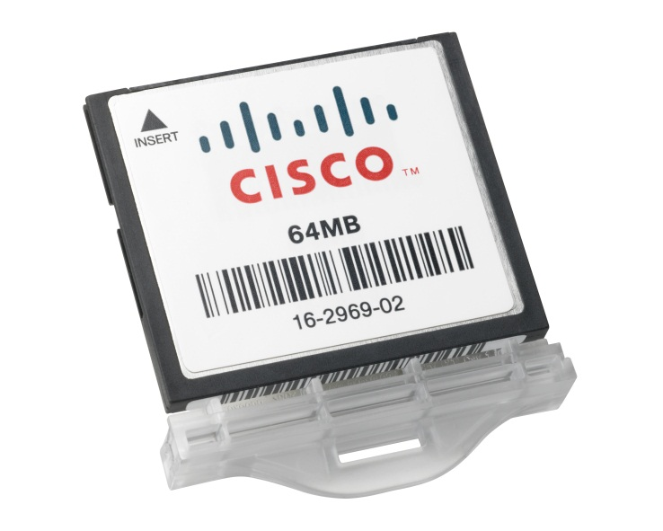
Cisco IOS
Location of the Cisco IOS
Cisco IOS stored in Flash
Non-volatile storage, not lost when power is lost
Can be changed or overwritten as needed
Can be used to store multiple versions of IOS
IOS copied from flash to volatile RAM
Quantity of flash and RAM memory determines IOS that can be used
Notes:
2.1.1.3 Location of the Cisco IOS

Slide 31
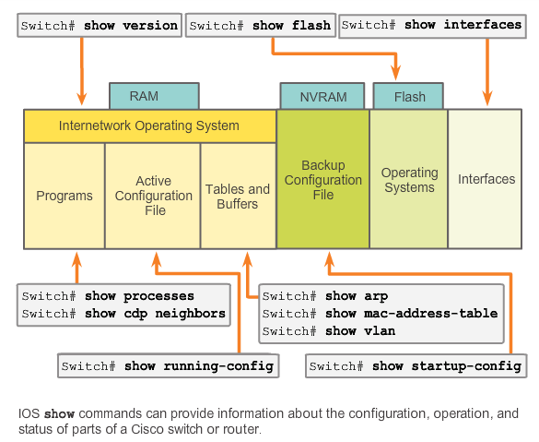
The Command Structure
IOS Examination Commands
Notes:
2.1.4.6 IOS Examination Commands
Use the show ? command to get a list of available commands in a given context, or mode.
A typical show command can provide information about the configuration, operation, and status of parts of a Cisco device.
A very commonly used show command is show interfaces. This command displays statistics for all interfaces on the device. To view the statistics for a specific interface, enter the show interfaces command followed by the specific interface type and slot/port number.
Some other show commands frequently used by network technicians include:
show startup-config - Displays the saved configuration located in NVRAM.
show running-config - Displays the contents of the currently running configuration file.

Slide 32
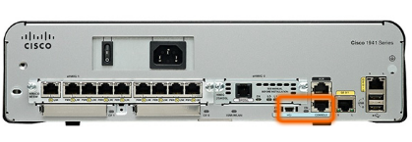
Accessing a Cisco IOS Device
Console Access Method
Most common methods to access the CLI:
Console
Telnet or SSH
AUX port
Notes:
2.1.2.1 Console Access Method

Slide 33
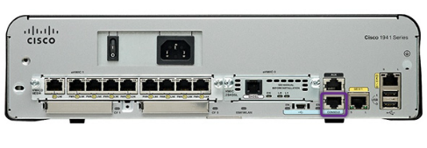
Accessing a Cisco IOS Device
Console Access Method
Console Port
Device is accessible even if no networking services have been configured (out-of-band)
Need a special console cable
Allows configuration commands to be entered
Should be configured with passwords to prevent unauthorized access
Device should be located in a secure room so console port cannot be easily accessed
Notes:
2.1.2.1 Console Access Method
Out-of-band access refers to access via a dedicated management channel that is used for device maintenance purposes only.
In the event that a password is lost, there is a special set of procedures for bypassing the password and accessing the device.

Slide 34
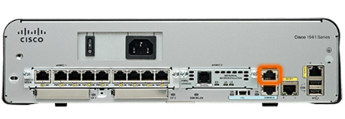

Accessing a Cisco IOS Device
Telnet, SSH, and AUX Access Methods
Telnet
Method for remotely accessing the CLI over a network
Require active networking services and one active interface that is configured
Secure Shell (SSH)
Remote login similar to Telnet, but utilizes more security
Stronger password authentication
Uses encryption when transporting data
Aux Port
Out-of-band connection
Uses telephone line
Can be used like console port
Notes:
2.1.2.2 Telnet, SSH, and AUX Access Methods

Slide 35
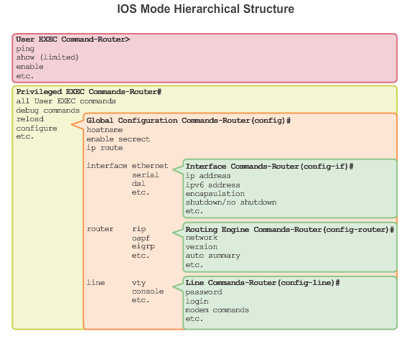
Navigating the IOS
Cisco IOS Modes of Operation
Notes:
2.1.3.1 Cisco IOS Modes of Operations
In hierarchical order from most basic to most specialized, the major modes are:
User executive (User EXEC) mode
Privileged executive (Privileged EXEC) mode
Global configuration mode
Other specific configuration modes, such as Interface configuration mode.
Each mode has a distinctive prompt

Slide 36
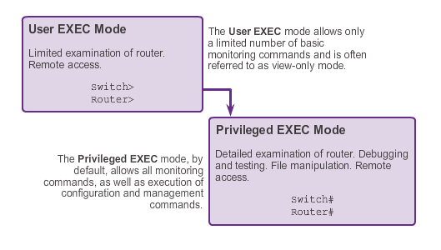
Navigating the IOS
Primary Modes
Notes:
2.1.3.2 Primary Modes
The two primary modes of operation are user EXEC mode and privileged EXEC mode. Tthe privileged EXEC mode has a higher level of authority in what it allows the user to do with the device.
User EXEC Mode
The user EXEC mode has limited capabilities but is useful for some basic operations. This mode is the first mode encountered upon entrance into the CLI of an IOS device.
This is often referred to as view-only mode. The user EXEC level does not allow the execution of any commands that might change the configuration of the device.
By default, there is no authentication required to access the user EXEC mode from the console. However, it is a good practice to ensure that authentication is configured during the initial configuration.
The user EXEC mode is identified by the CLI prompt that ends with the > symbol. This is an example that shows the > symbol in the prompt: Switch>
Privileged EXEC Mode
The execution of configuration and management commands requires that the network administrator use the privileged EXEC mode, or a more specific mode in the hierarchy.
The privileged EXEC mode can be identified by the prompt ending with the #symbol. Switch#
By default, privileged EXEC mode does not require authentication.
Global configuration mode and all other more specific configuration modes can only be reached from the privileged EXEC mode.

Slide 37
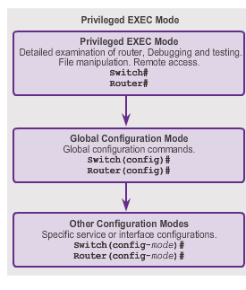
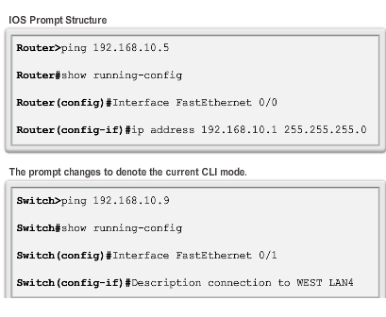
Navigating the IOS
Global Configuration Mode and Submodes
Notes:
2.1.3.3 Global Configuration Mode and Submodes
Global configuration mode and interface configuration modes can only be reached from the privileged EXEC mode.
From global config, CLI configuration changes are made that affect the operation of the device as a whole.
Switch# configure terminal
Switch(config)#
From the global config mode, the user can enter different subconfiguration modes. Each of these modes allows the configuration of a particular part or function of the IOS device.
Interface mode - to configure one of the network interfaces (Fa0/0, S0/0/0)
Line mode - to configure one of the physical or virtual lines (console, AUX, VTY)
To exit a specific configuration mode and return to global configuration mode, enter exit at a prompt. To leave configuration mode completely and return to privileged EXEC mode, enter end or use the key sequence Ctrl-Z.
As commands are used and modes are changed, the prompt changes to reflect the current context.

Slide 38
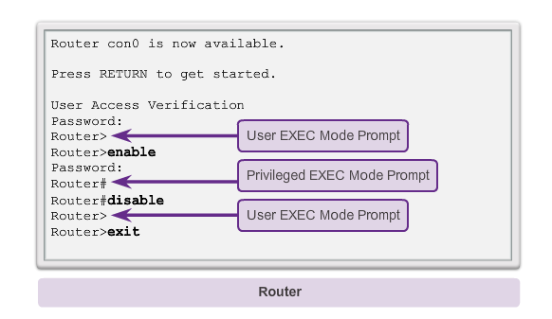
Navigating the IOS
Navigating Between IOS Modes
Notes:
2.1.3.4 Navigating between IOS Modes
The enable and disable commands are used to change the CLI between the user EXEC mode and the privileged EXEC mode, respectively.

Slide 39
The Command Structure
Hot Keys and Shortcuts
Tab – Completes the remainder of a partially typed command or keyword.
Ctrl-R – Redisplays a line.
Ctrl-A – Moves to the beginning of the line.
Ctrl-Z – Exits the configuration mode and returns to user EXEC.
Down Arrow – Allows the user to scroll forward through former commands.
Up Arrow – Allows the user to scroll backward through former commands.
Ctrl-shift-6 – Allows the user to interrupt an IOS process such as ping or traceroute.
Ctrl-C – Exits the current configuration or aborts the current command.
Notes:
2.1.4.5 Hot Keys and Shortcuts
Tab - This is a good technique to use when you are learning because it allows you to see the full word used for the command or keyword.
Ctrl-Z - Because the IOS has a hierarchical mode structure, you may find yourself several levels down. Rather than exit each mode individually, use Ctrl-Z to return directly to the privileged EXEC prompt at the top level.
Ctrl-Shift-6 - Using the escape sequence. When an IOS process is initiated from the CLI, such as a ping or traceroute, the command runs until it is complete or is interrupted. While the process is running, the CLI is unresponsive. To interrupt the output and interact with the CLI, press Ctrl-Shift-6.
Commands and keywords can be abbreviated to the minimum number of characters that -identify a unique selection.

Slide 40
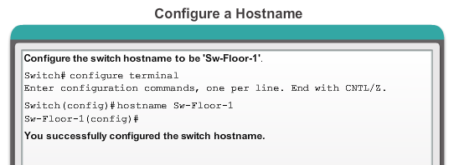
Hostnames
Configuring Hostnames
Notes:
2.2.1.4 Configuring Hostnames

Slide 41
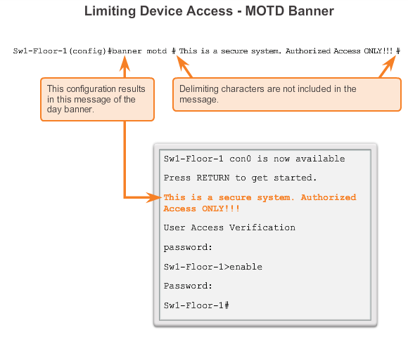
Limiting Access to Device Configurations
Banner Messages
Important part of the legal process in the event that someone is prosecuted for breaking into a device
Wording that implies that a login is "welcome" or "invited" is not appropriate
Often used for legal notification because it is displayed to all connected terminals
Notes:
2.2.2.5 Banner Messages

Slide 42
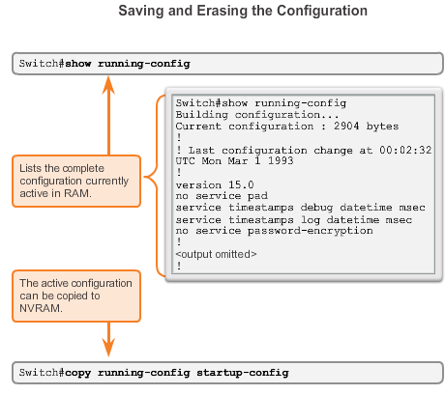
Saving Configurations
Configuration Files
Switch# reload
  System configuration has been modified. Save? [yes/no]: n
  Proceed with reload? [confirm]
Startup configuration is removed by using the erase startup-config
  Switch# erase startup-config
On a switch, you must also issue the delete vlan.dat
  Switch# delete vlan.dat
  Delete filename [vlan.dat]?
  Delete flash:vlan.dat? [confirm]
Notes:
2.2.3.1 Configuration Files
Switch# erase startup-config
After the command is issued, the switch will prompt you for confirmation:
Erasing the nvram filesystem will remove all configuration files! Continue? [confirm]
Confirm is the default response. To confirm and erase the startup configuration file, press . Pressing any other key will abort the process.

Slide 43
Limiting Access to Device Configurations
Securing Device Access
These are device access passwords:
enable password – Limits access to the privileged EXEC mode
enable secret – Encrypted, limits access to the privileged EXEC mode
console password – Limits device access using the console connection
VTY password – Limits device access over Telnet
Note: In most of the labs in this course, we will be using simple passwords such as cisco or class.
Notes:
2.2.2.1 Securing Device Access
Consider these key points when choosing passwords:
Use passwords that are more than eight characters in length.
Use a combination of upper and lowercase letters, numbers, special characters, and/or numeric sequences in passwords.
Avoid using the same password for all devices.
Avoid using common words such as password or administrator, because these are easily guessed

Slide 44
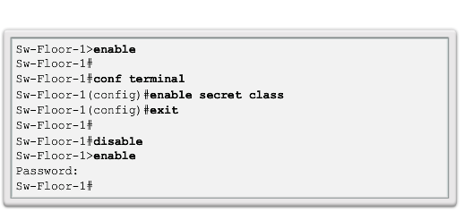
Limiting Access to Device Configurations
Securing Privileged EXEC Access Mode
Use the enable secret command, not the older enable password command.
The enable secret command provides greater security because the password is encrypted.
Notes:
2.2.2.2 Securing Privileged EXEC Access

Slide 45
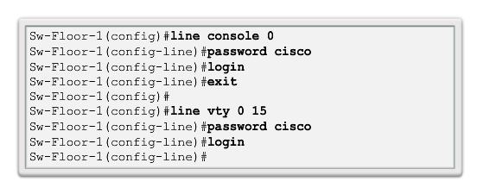
Limiting Access to Device Configurations
Securing User EXEC Access
Console port must be secured; it reduces the chance of unauthorized personnel physically plugging a cable into the device and gaining device access.
VTY lines allow access to a Cisco device via Telnet. The number of VTY lines supported varies with the type of device and the IOS version.
Notes:
2.2.2.3 Securing User EXEC Access

Slide 46
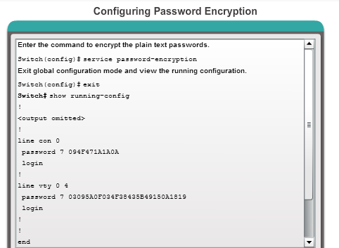
Limiting Access to Device Configurations
Encrypting Password Display
service password-encryption
Prevents passwords from showing up as plain text when viewing the configuration
Keeps unauthorized individuals from viewing passwords in the configuration file
Once applied, removing the encryption service does not reverse the encryption
Notes:
2.2.2.4 Encrypting Password Display

Slide 47
CCNA 1
Chapter 3 - Network Protocols and Communication

Slide 48
CCNA 1
Chapter 4 - Network Access

Slide 49
CCNA 1
Chapter 5 - Ethernet

Slide 50
CCNA 1
Chapter 6 - Network Layer

Slide 51
CCNA 1
Chapter 7 - Transport Layer

Slide 52
CCNA 1
Chapter 8 - IP Addressing

Slide 53
CCNA 1
Chapter 9 - Subnetting IP Networks

Slide 54
CCNA 1
Chapter 10 - Application Layer

Slide 55
CCNA 1
Chapter 11 - It’s a Network

Slide 56
CCNA 2
Chapter -1 - Introduction to Switched Networks

Slide 57
CCNA 2
Chapter -2 - Introduction to Switched Networks

Slide 58
CCNA 2
Chapter -3 - VLANs

Slide 59
CCNA 2
Chapter -4 - Routing Concepts

Slide 60
CCNA 2
Chapter -5 - Inter-VLAN Routing

Slide 61
CCNA 2
Chapter -6 - Static Routing

Slide 62
CCNA 2
Chapter -7 - Routing Dynamically

Slide 63
CCNA 2
Chapter -8 - Single-Area OSPF

Slide 64
CCNA 2
Chapter -9 - Access Control Lists

Slide 65
CCNA 2
Chapter -10 - DHCP

Slide 66
CCNA 2
Chapter -11 - Network Address Translation

